Slide 1

Report Analytics & Dashboard Analytics for Stake-Holders
01
Inventory Dashboard
06
02
05
04
03

Slide 2
Project Steps for Supply Chain Data Analysis
Tools Used: Excel, Tableau, Power BI, MY SQL.
Step-by-Step Workflow:
Excel Dashboard: Create an initial dashboard using provided Excel data.
SQL Integration: Load files into a SQL database under a Supply Chain data schema.
BI Tool Connection: Connect SQL database to Tableau/Power BI and create a data model with necessary joins.
Dashboard Development: Build interactive dashboards in Tableau and Power BI.
Quality Assurance (QA): Validate data by comparing database records with dashboards to ensure accuracy.
Final Presentation : Create Final Presentation and Present with PPT order
1-Group Details
2-Summary about the Project
3-KPI List
4-Excel Dashboard
5-Tableau Dashboard
6-Power BI Dashboard
7-SQL Query Image
8-Key Takeaway

Slide 3
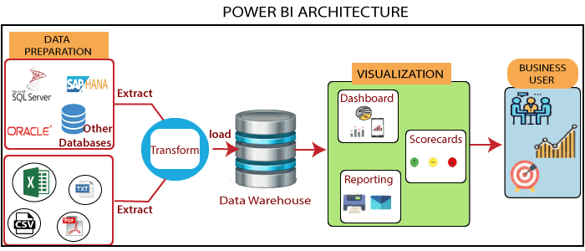

Slide 4
Project Steps for Supply Chain Data Analysis
Tools Used: Excel, Tableau, Power BI, MY SQL.
Step-by-Step Workflow:
Excel Dashboard: Create an initial dashboard using provided Excel data.
SQL Integration: Load files into a SQL database under a Supply Chain data schema.
BI Tool Connection: Connect SQL database to Tableau/Power BI and create a data model with necessary joins.
Dashboard Development: Build interactive dashboards in Tableau and Power BI.
Quality Assurance (QA): Validate data by comparing database records with dashboards to ensure accuracy.
Final Presentation : Create Final Presentation and Present with PPT order
1-Group Details
2-Summary about the Project
3-KPI List
4-Excel Dashboard
5-Tableau Dashboard
6-Power BI Dashboard
7-SQL Query Image
8-Key Takeaway

Slide 5
Report Analytics & Dashboard Analytics for Stake-Holders
Supply Chain Dashboard KPI
Total Sales (MTD, QTD, YTD):
Tracks the total sales achieved within different time periods:
MTD (Month-to-Date): Sales from the start of the current month up to the current date.
QTD (Quarter-to-Date): Sales from the start of the current quarter up to the current date.
YTD (Year-to-Date): Sales from the start of the year up to the current date.
Product Wise Sales:
Monitors sales figures segmented by individual products or product categories to identify top-performing and underperforming products.
Sales Growth:
Measures the percentage increase or decrease in sales compared to a previous period (e.g., month-over-month or year-over-year growth).
Daily Sales Trend:
Analyzes sales performance on a daily basis to spot patterns, peaks, or dips in sales activity.
State Wise Sales:
Provides sales data broken down by states or geographical areas to identify regional performance trends.
Top 5 Store Wise Sales:
Highlights the five stores with the highest sales, helping to identify star performers and best practices.
Region Wise Sales:
Tracks sales across various regions, which may include multiple states or territories, for macro-level performance insights.
Total Inventory:
Shows the total stock quantity available in hand across all warehouses or locations.
Inventory Value:
Represents the monetary value of the current inventory based on cost or market value.
Overstock, Out-of-stock, Under-stock:
Categorizes inventory health into three states:
In-stock: Inventory in hand is equal to or greater than the minimum stock quantity required.
Out-of-stock: Inventory in hand is less than 0 (no stock available).
Under-stock: Inventory in hand is less than the desired stock quantity but not entirely out of stock.
Purchase Method Wise Sales:
Breaks down sales based on the method of purchase, such as online, in-store, cash, or credit card.

